Slide 1
Hospital Management System
Submitted BY: 21-SE-039 Ayesha Rafiq

Slide 2
Objective
The objective of the Hospital Management System (HMS) is to streamline the operations and management of hospital activities. This system aims to improve the efficiency and effectiveness of hospital administration by automating processes related to patient management, appointment scheduling, billing, inventory management, and more. The primary goals are to enhance patient care, reduce administrative workload, and provide comprehensive data management capabilities.

Slide 3
Key Features:
Authentication System
Provides secure login and signup functionalities.
Ensures that only authorized personnel can access the system.
Dashboard
Central hub for navigating the HMS.
Contains quick links to all key modules such as Patients, Appointments, Billing, Inventory, Doctors, and Departments.
Patient Management
Manages patient information efficiently.
Allows adding, updating, and viewing patient records.

Slide 4
Key Features:
Appointment Scheduling
Facilitates the booking and management of patient appointments.
Displays appointments in a calendar view for easy tracking.
Billing System
Automates the billing process.
Generates bills for patient services and treatments.
Inventory Management
Tracks hospital inventory, including medical supplies and equipment.
Helps in maintaining adequate stock levels.

Slide 5
Key Features:
Doctor Management
Manages doctor profiles and their availability.
Assigns doctors to specific departments and appointments.
Department Management
Organizes hospital departments for better structure.
Links departments with doctors and services offered.
About Us and Contact Us Pages
Provides information about the hospital and its services.
Includes contact details for reaching out to the hospital.
Social Media Integration
Includes social media icons for Twitter, Instagram, and LinkedIn.
Enhances the hospital's online presence and connectivity.

Slide 6
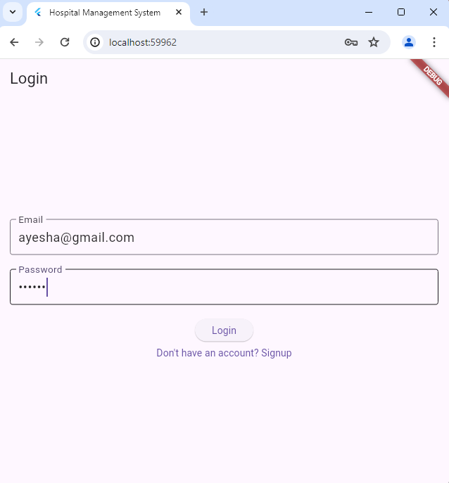
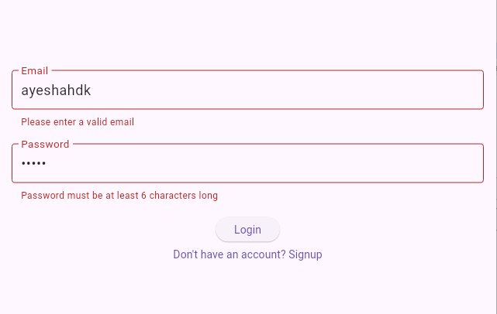
Login Screen
Validation for email and password

Slide 7
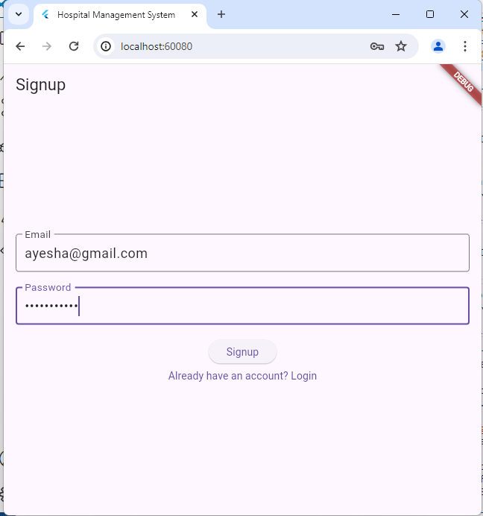
Signup screen

Slide 8
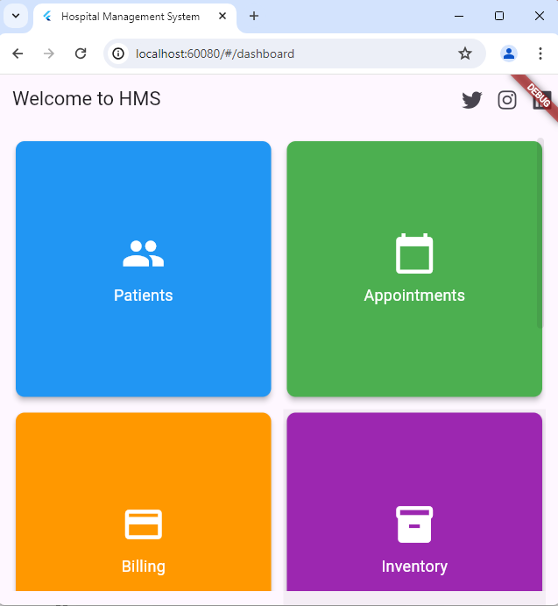
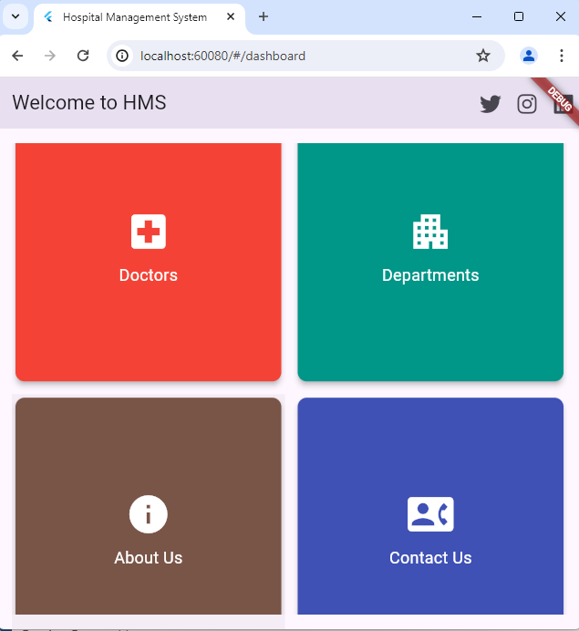
Home Page

Slide 9
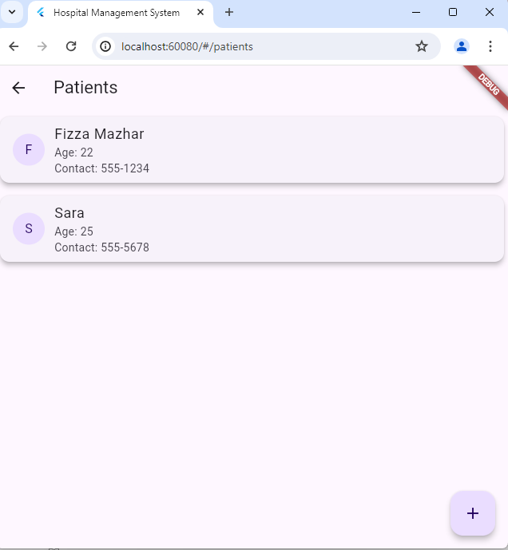
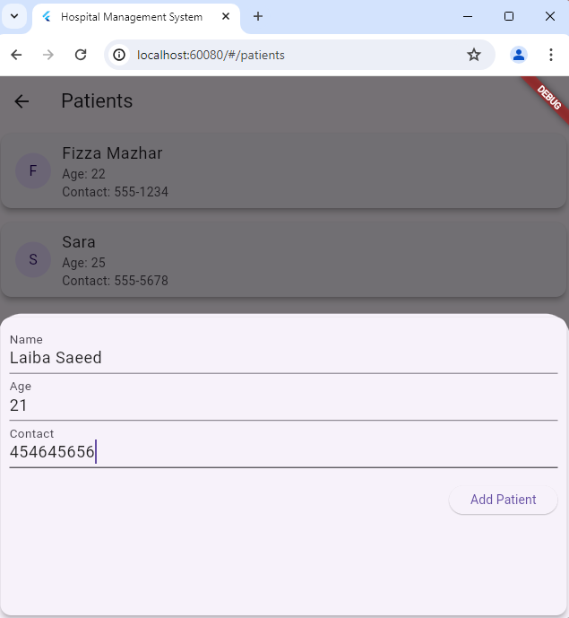
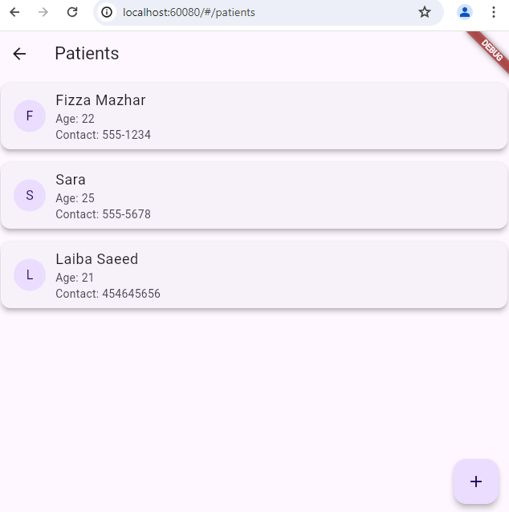
Patient Screen

Slide 10
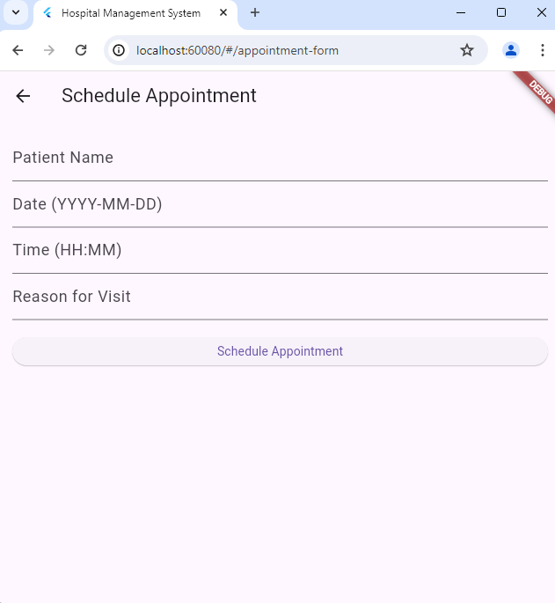
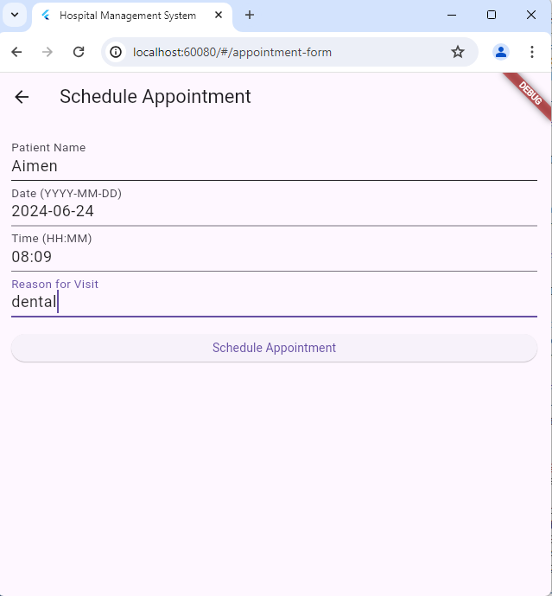
Schedule Appointment

Slide 11
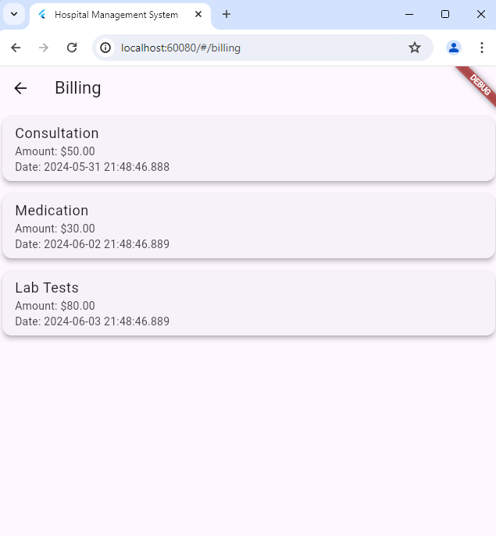
Billing Screen

Slide 12
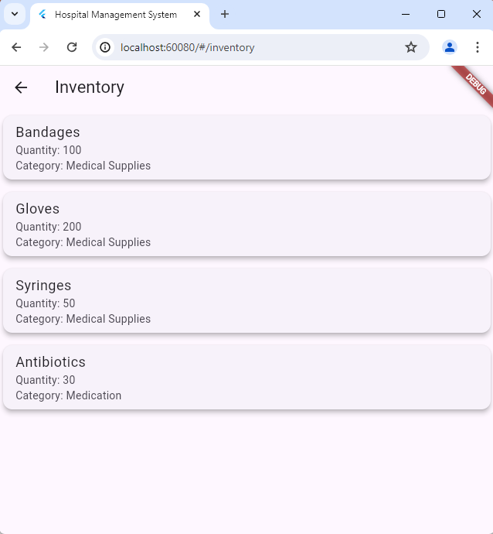
Inventory screen

Slide 13
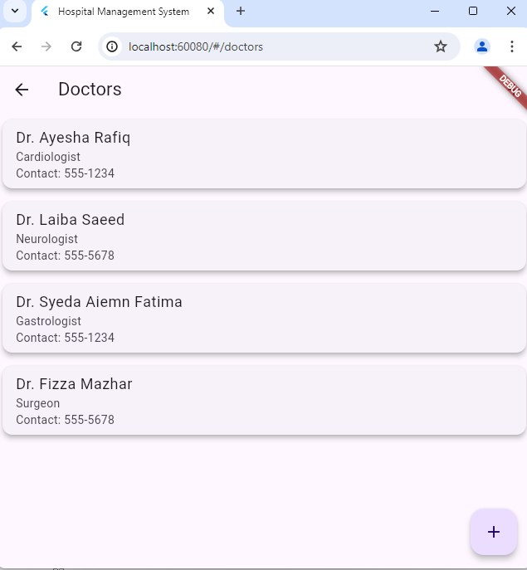
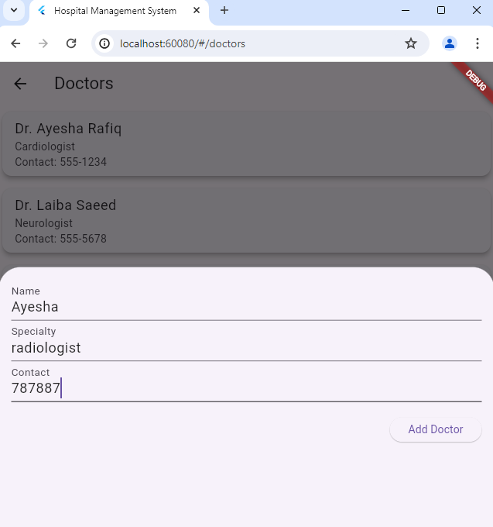
Doctors Screen

Slide 14
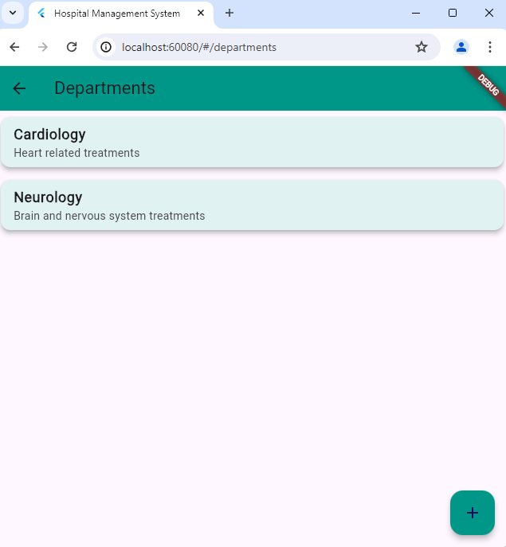
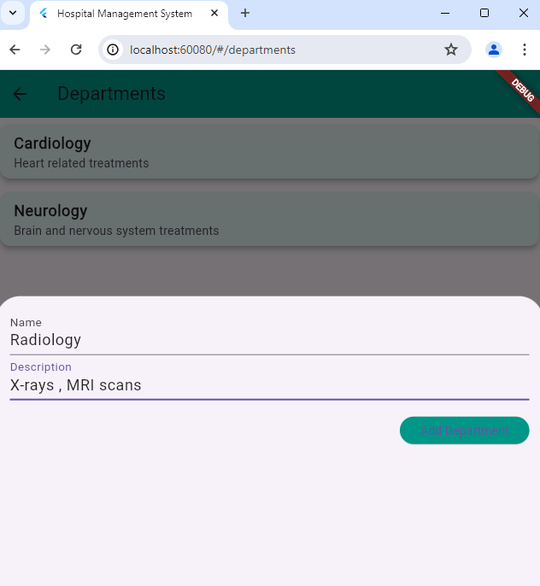
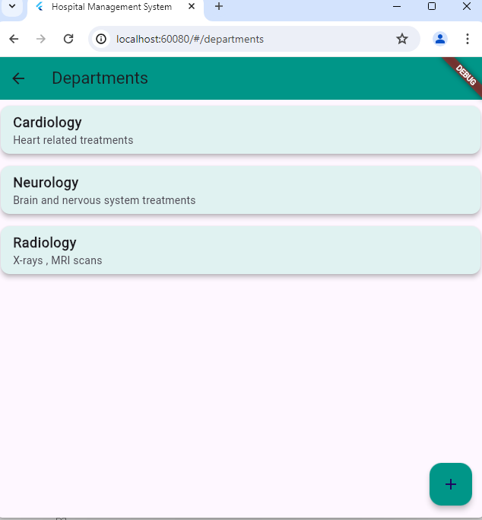
Departments

Slide 15
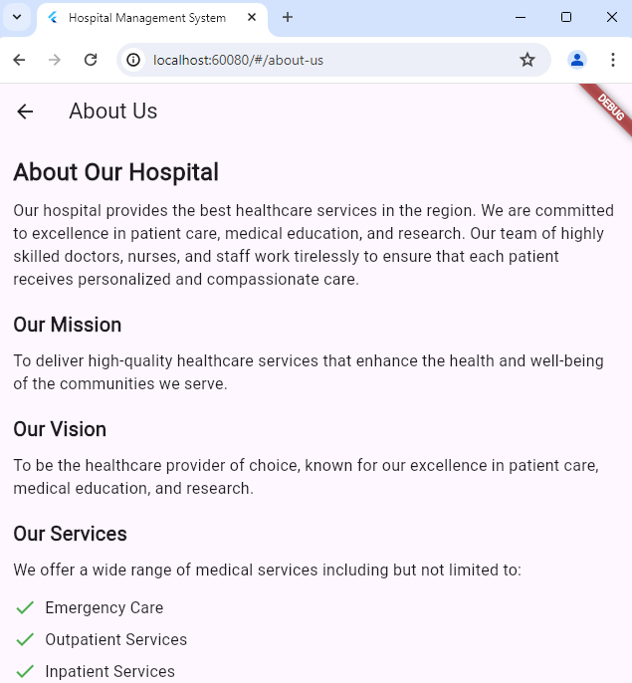
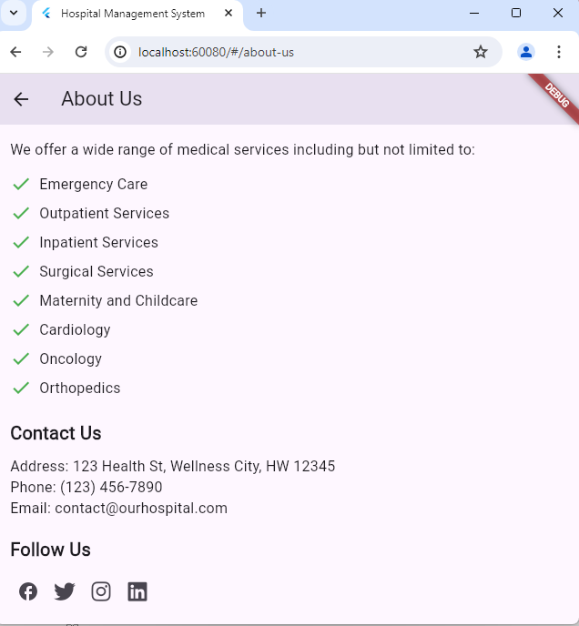
About Us

Slide 16
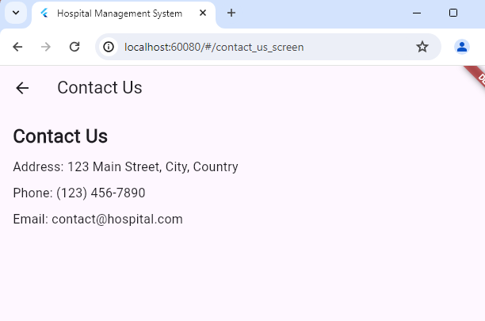
Contact US

